Slide 1


Slide 2
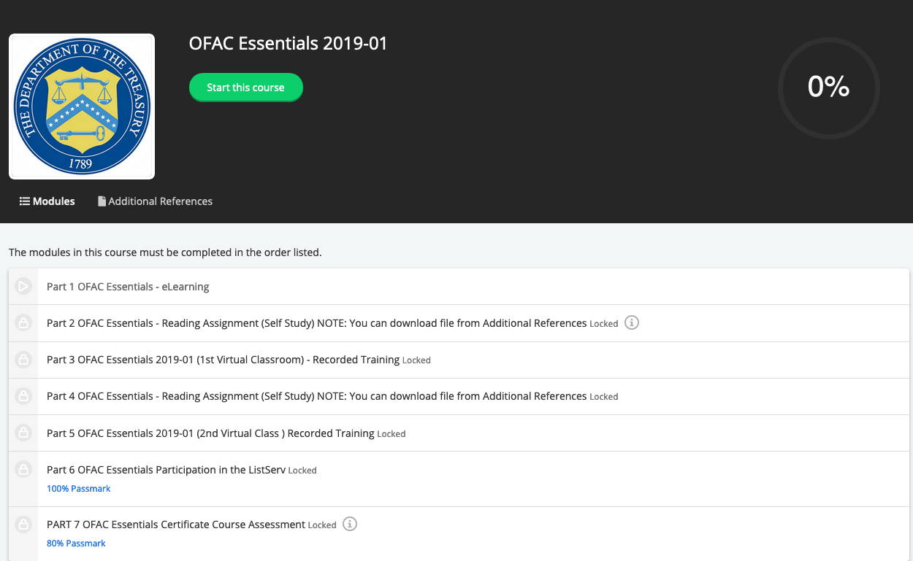
Overview
Additional References
Contains the reading Material and Part 1 in video format
Modules
Contains the 7 sections that have to be completed before receiving your certificate.

Slide 3
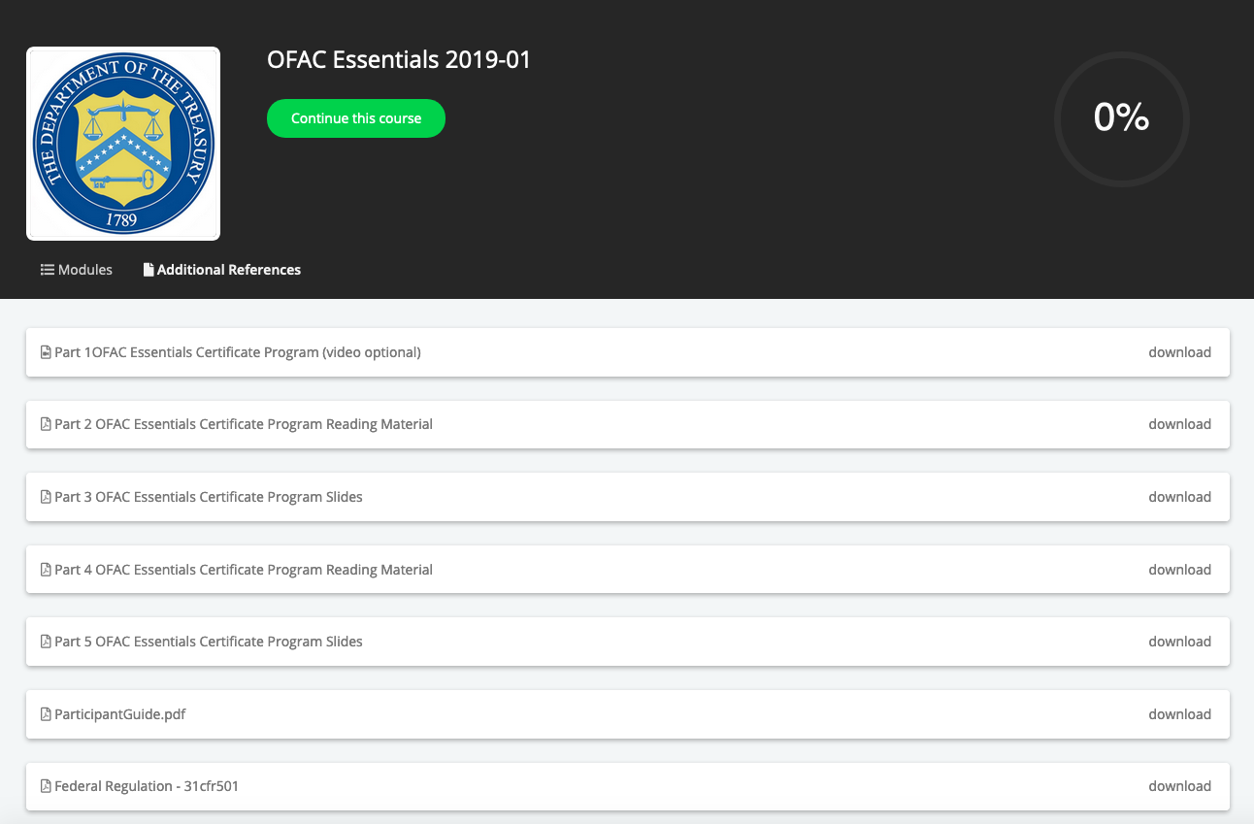
Reference Material
Part 1:
We have included the eLearning course in video format for review at a later time

Slide 4
Modules
Part 1:
eLearning Course

Slide 5
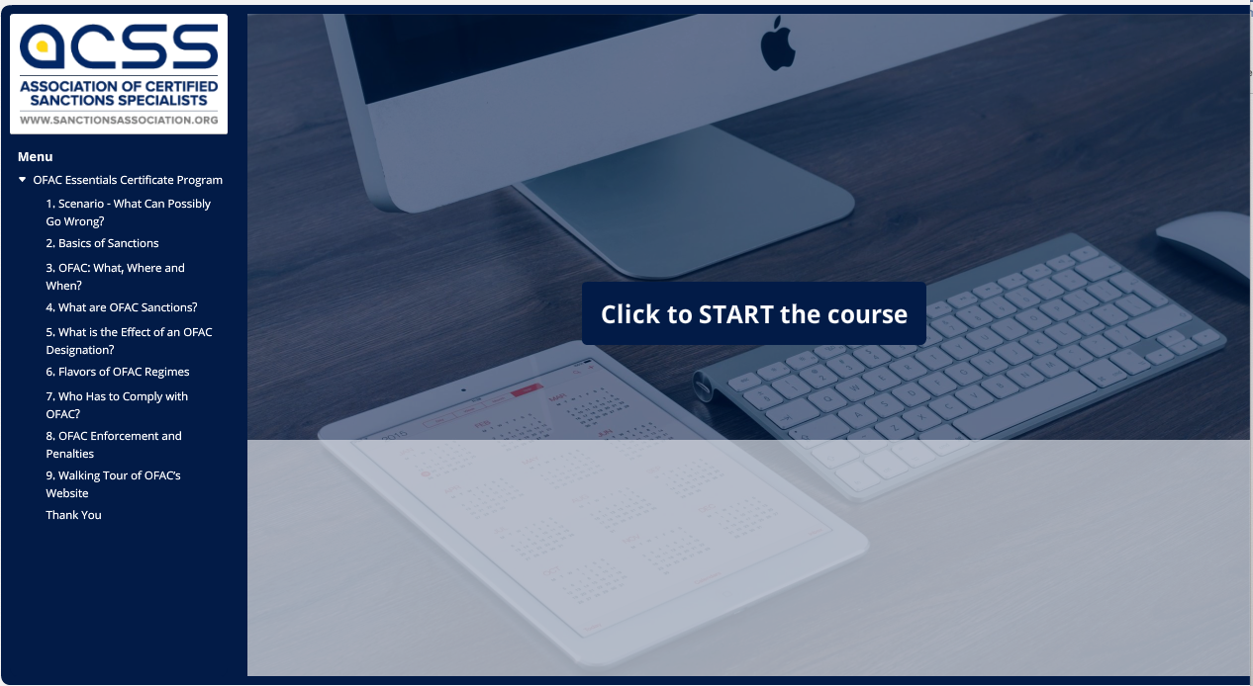
Part 1: eLearning Material

